Slide 1
Shaping Culture and Leadership in NHS Wales​
Module 4 : Core needs and
the courage of self-compassion
Developed with Professor Michael West

Slide 2
Module 4: Core needs and the courage of self-compassion
To understand and apply knowledge about core needs at work
Understanding of recovery, ways to wellbeing and the practice of RAIN
To develop the understanding and motivation to practice self-compassion
Putting it into Practice
Develop action plans and brief for self-directed learning

Slide 3
Compassionate Leadership
Core Needs of Work
Compassionate leaders must constantly focus on meeting the core needs of people at work. This leads to high intrinsic motivation and better well-being.

Slide 4
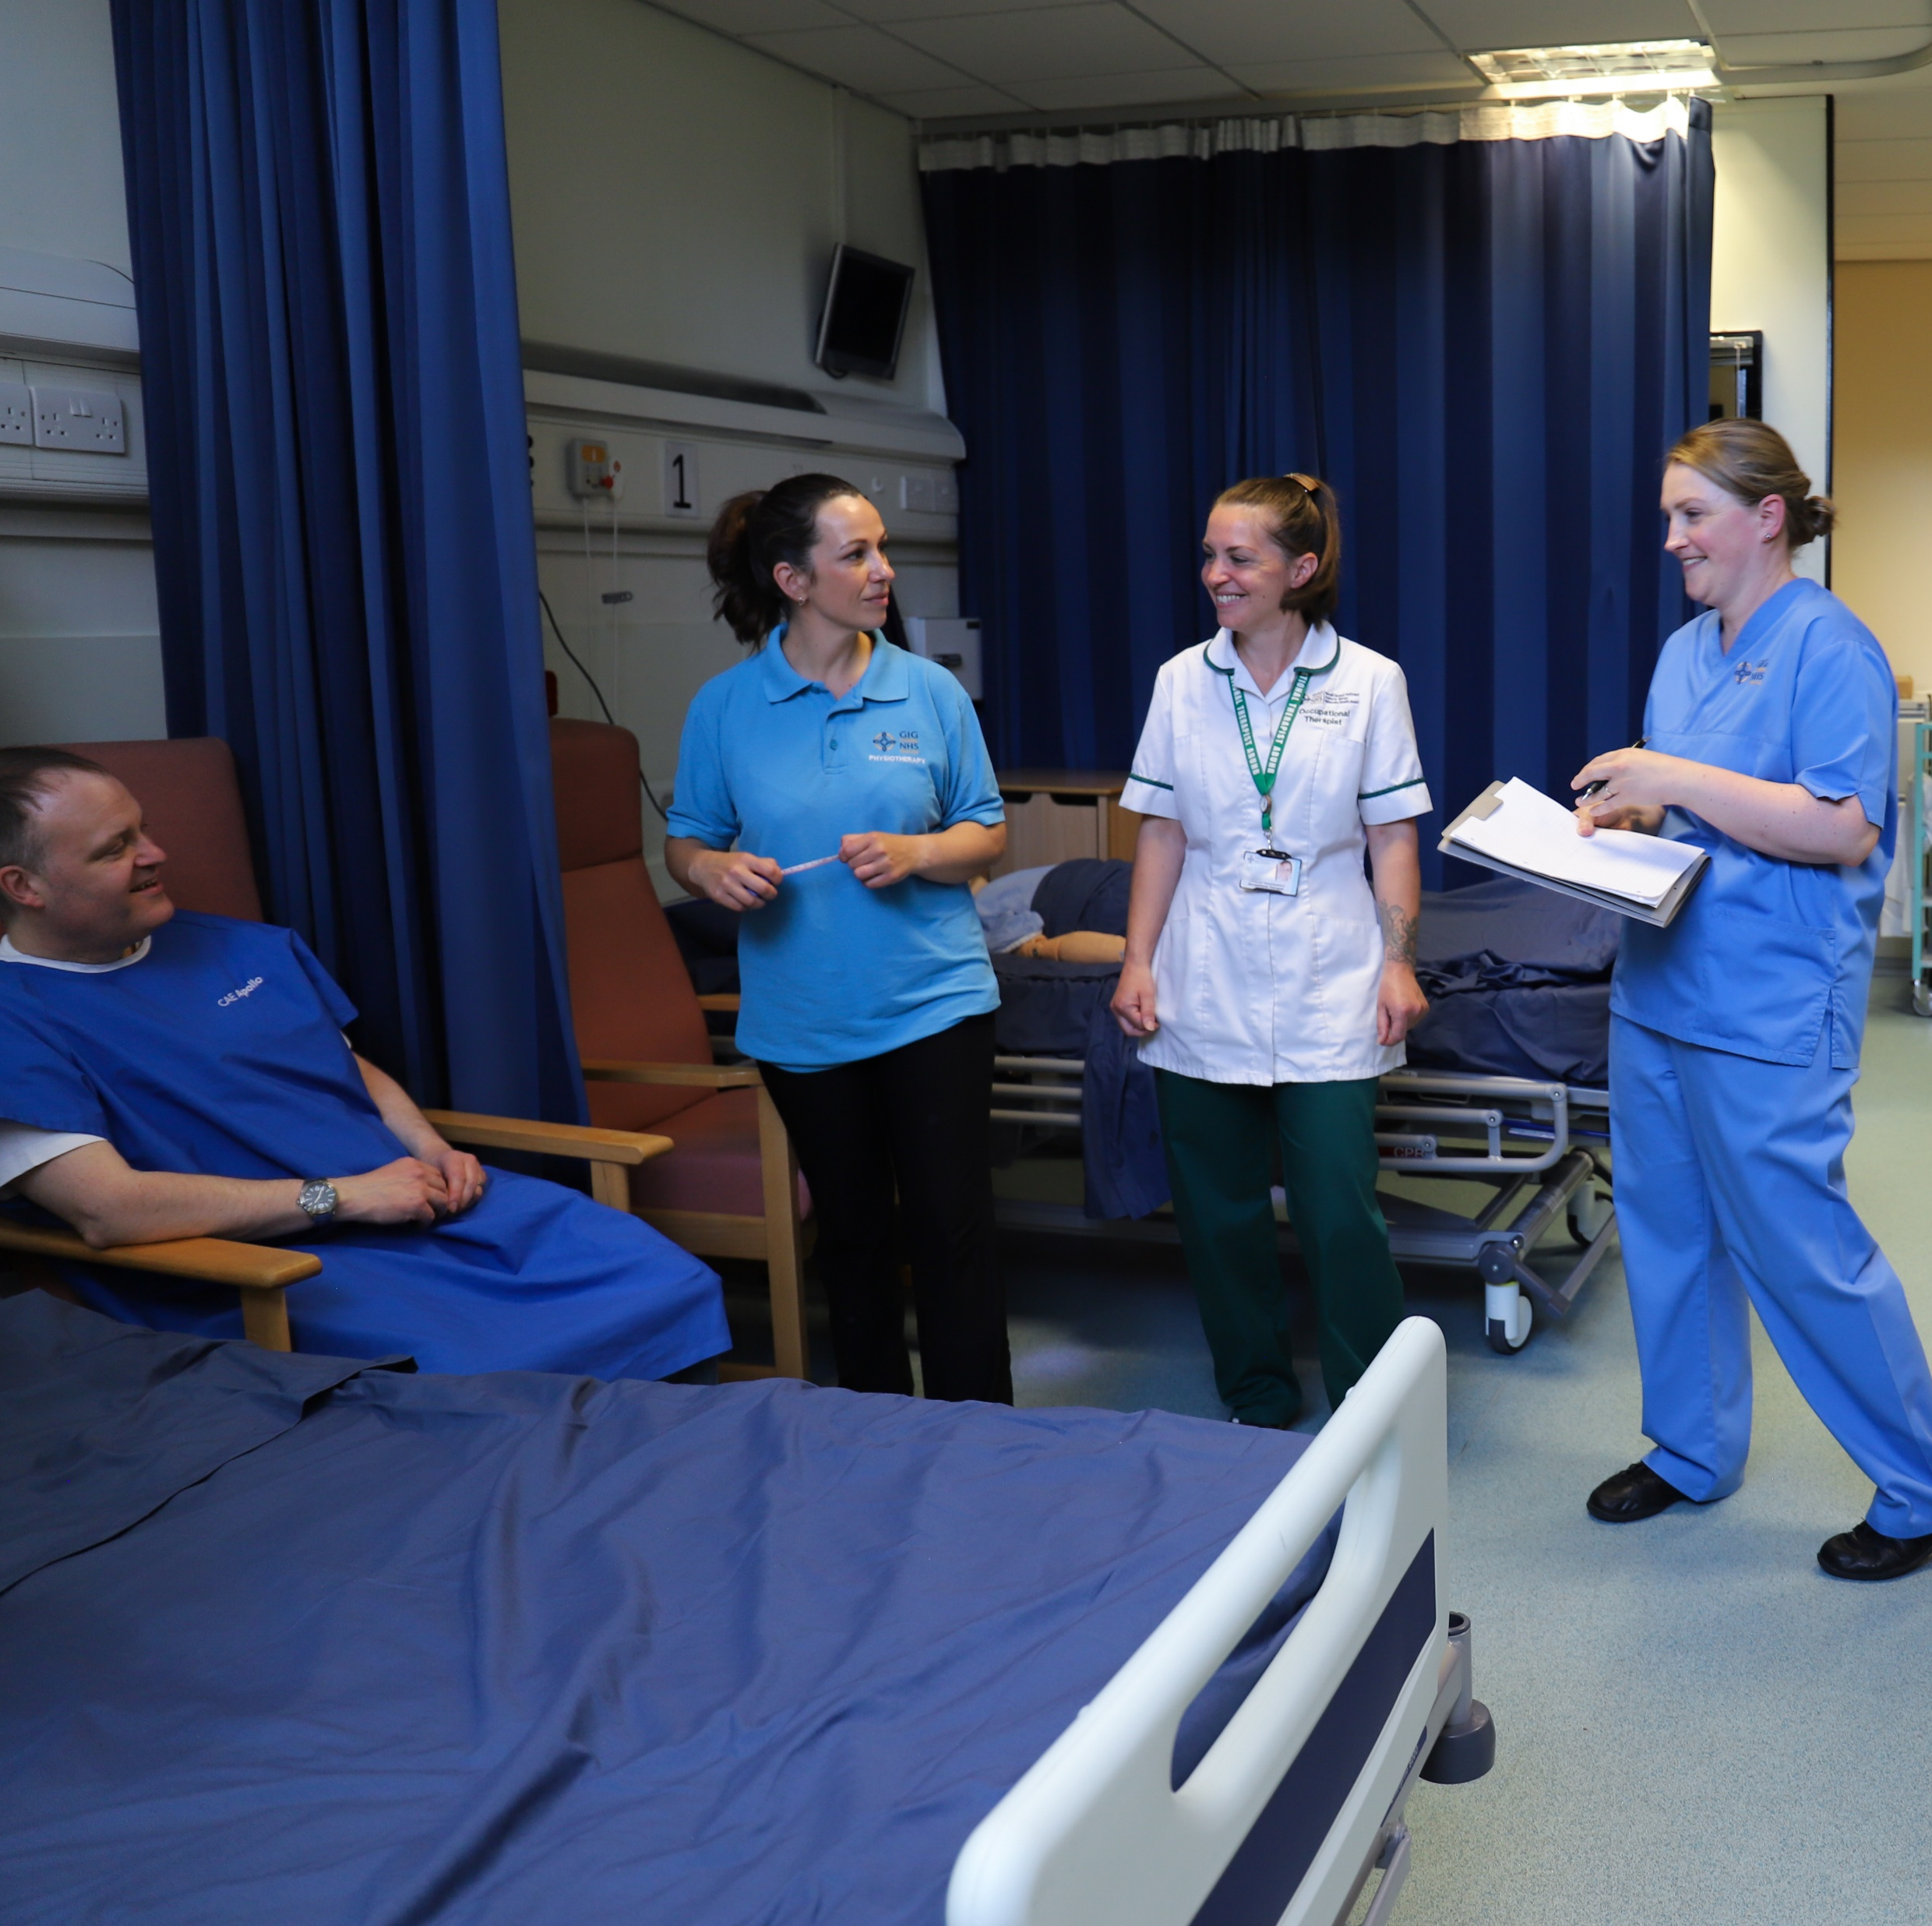
Exercise
Compassionate Leadership
Core Needs
1

Slide 5
Compassionate Leadership
Authority, empowerment & influence
Justice & Fairness
Work conditions & working schedules
Teamworking
Culture & Leadership
Workload
Management & Supervision
Education, Learning & Development
Core Needs of Work

Slide 6
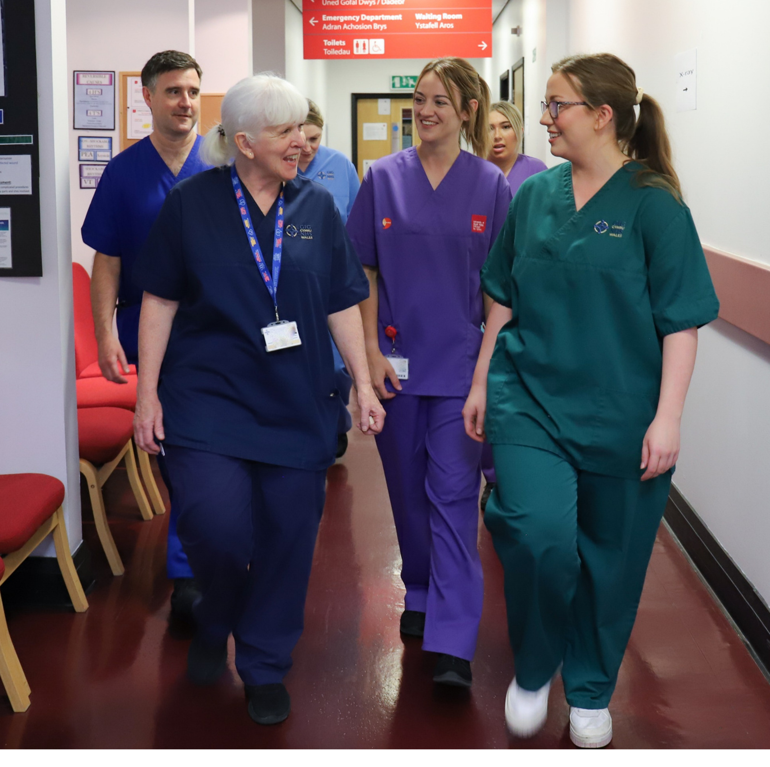
Exercise
Compassionate Leadership
Core Needs –
The Eight Areas of Action
2

Slide 7
Exercise
The Practice of Self Compassion
What It Is
and Is Not
3
4
3

Slide 8
Exercise
Understanding of Recovery
Activities that aid recovery enable psychological detachment from work
Relaxation/Meditation
Mastery - achievement from challenging tasks
Control - what to do and when in non-work time
Breaks and their importance on our recovery
Environment
5

Slide 9
Exercise
Six Ways to Wellbeing
Belonging
Sleep
Exercise
Being Present
Learning
Giving
6

Slide 10
The Practice of RAIN
Recognising
Allowing or Accepting
Investigation or Inquiring
Nurturing

Slide 11
Exercise
Putting It Into Practice
Two key elements of self-compassion:
1) Cultivating our ability to be present
2) Understanding the challenges we face as leaders
7
8
9

Slide 12
Exercise
Action Plans
Putting your learning
into practice
1) Translate actions into goals and sustained behaviours
2) Value gained from embedding goals via self-directed learning programme
Next Steps
Let’s get action planning
10

Slide 13
Thank you for attending the four modules of Compassionate Leadership

