Slide 1
Staff Survey Dashboard - All Wales
View in Power BI
Last data refresh:
22/02/2024 16:28:24 UTC
Downloaded at:
23/02/2024 13:57:16 UTC

Slide 2
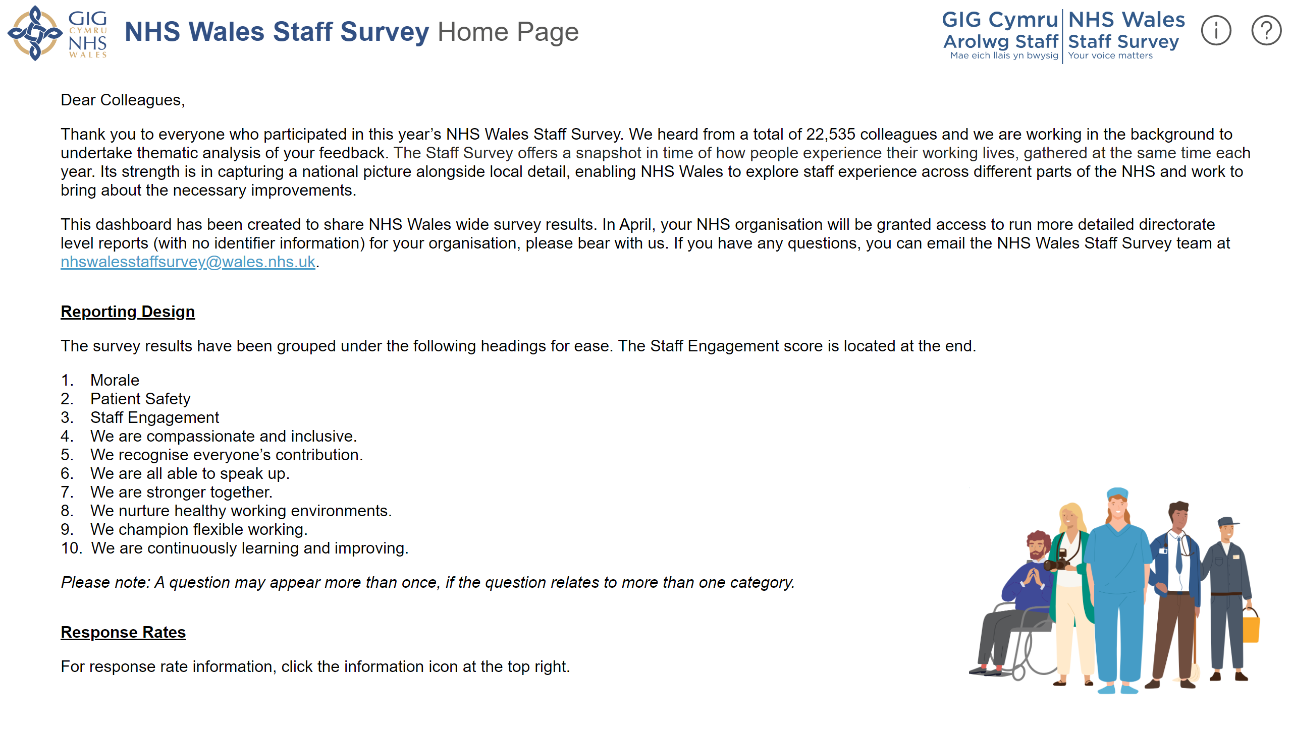
Home Page
Notes:
Question Mark
No alt text provided
Exclamation Mark
No alt text provided
NHS Wales Logo
No alt text provided
Staff Survey Logo
No alt text provided
Strapline
No alt text provided
textbox
No alt text provided
image
No alt text provided
actionButton
No alt text provided
textbox
No alt text provided
shape
No alt text provided
shape
No alt text provided

Slide 3
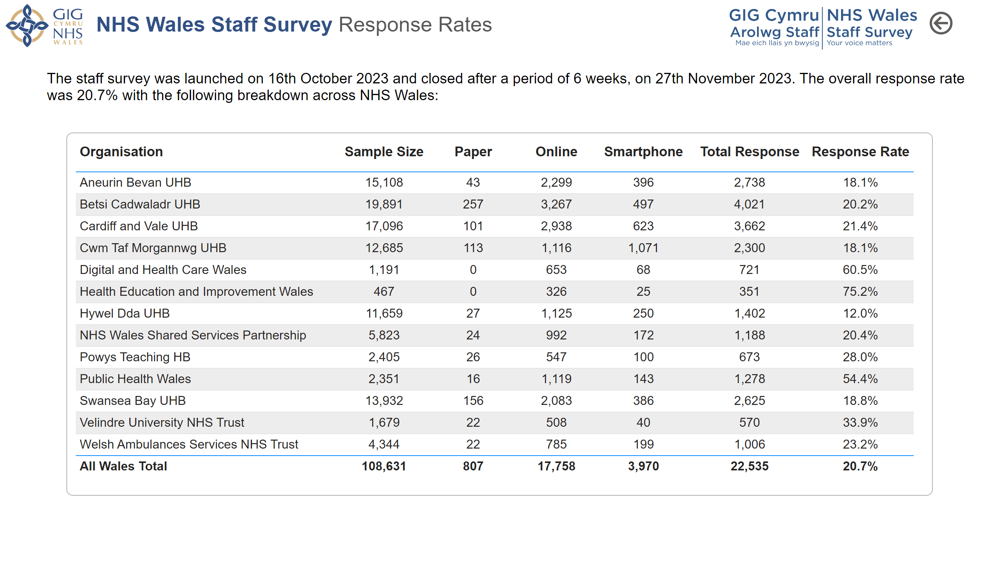
Response Rates
Notes:
NHS Wales Logo
No alt text provided
Staff Survey Logo
No alt text provided
Strapline
No alt text provided
textbox
No alt text provided
tableEx
No alt text provided
Back Button
No alt text provided

Slide 4
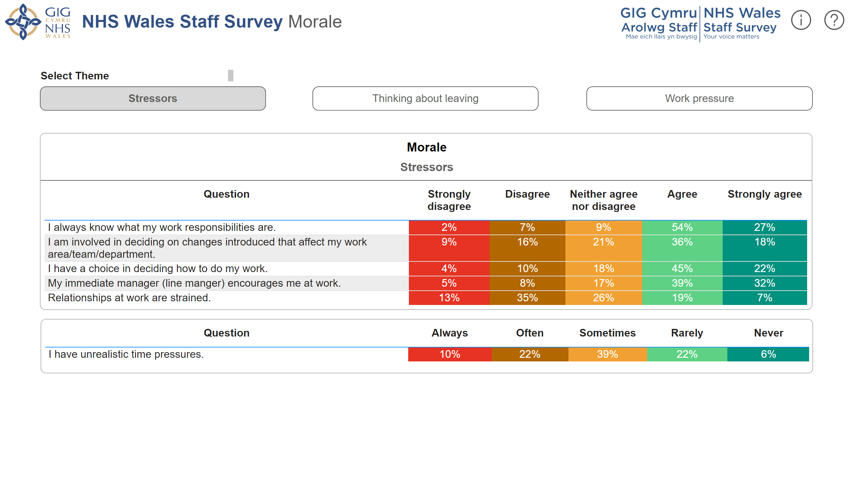
Morale
Notes:
Morale
No alt text provided
Morale
No alt text provided
Theme Text Box
No alt text provided
actionButton
No alt text provided
actionButton
No alt text provided
actionButton
No alt text provided
Staff Survey Logo
No alt text provided
NHS Wales Logo
No alt text provided
Strapline
No alt text provided
Question Mark
No alt text provided
Exclamation Mark
No alt text provided
actionButton
No alt text provided
shape
No alt text provided
textbox
No alt text provided
shape
No alt text provided
textbox
No alt text provided
shape
No alt text provided

Slide 5
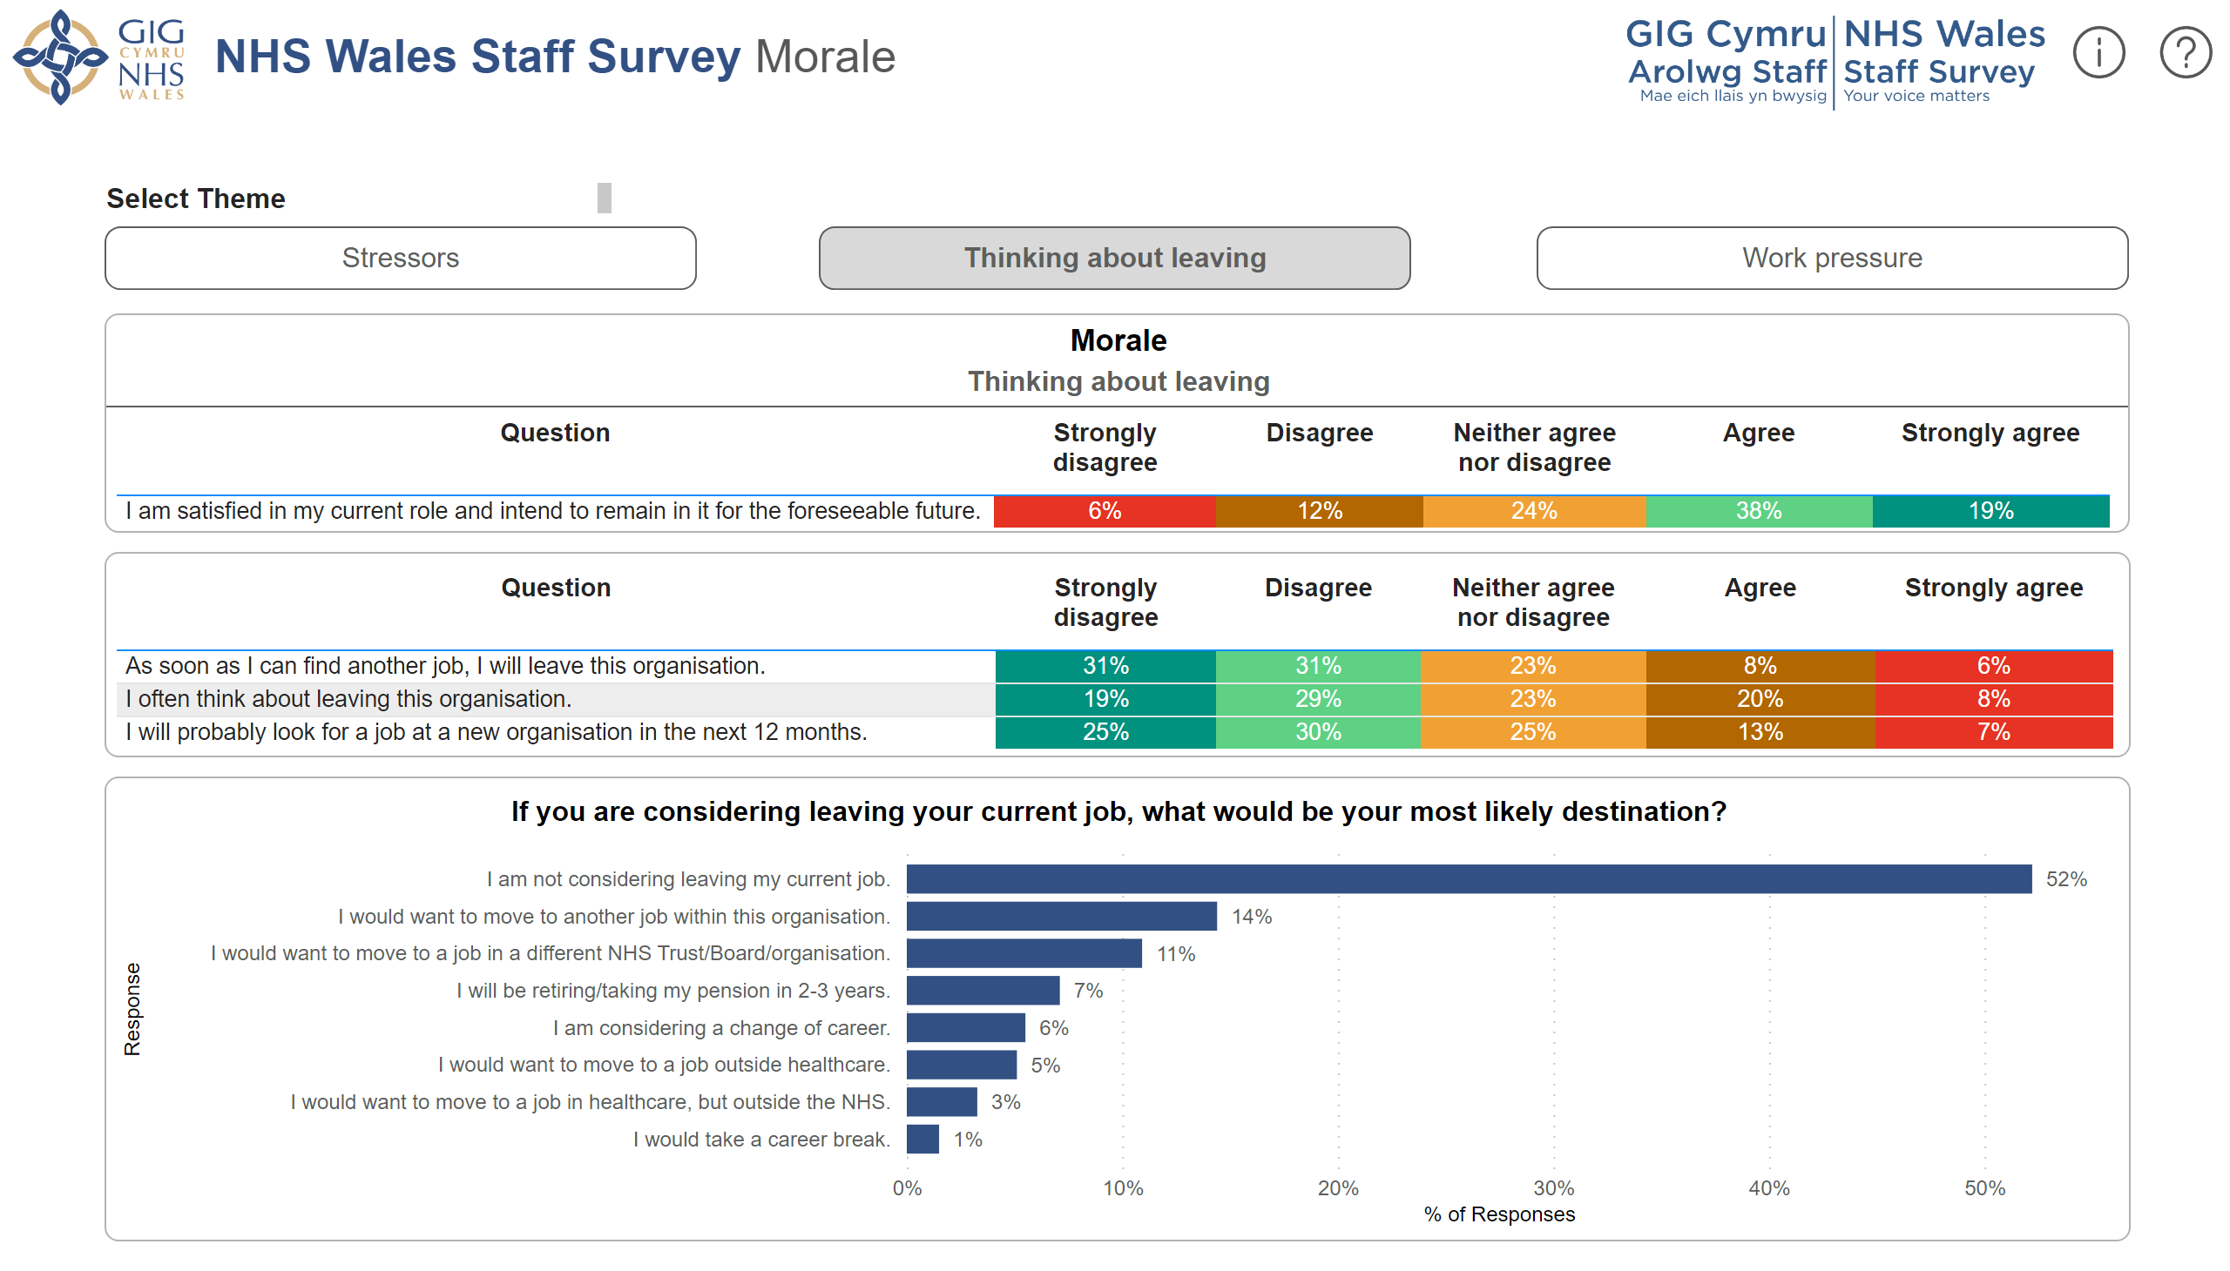
Morale (2)
Notes:
Question Mark
No alt text provided
Exclamation Mark
No alt text provided
Theme Text Box
No alt text provided
actionButton
No alt text provided
actionButton
No alt text provided
actionButton
No alt text provided
Staff Survey Logo
No alt text provided
NHS Wales Logo
No alt text provided
Strapline
No alt text provided
Morale
No alt text provided
If you are considering leaving your current job, what would be your most likely destination?
No alt text provided
Morale
No alt text provided
actionButton
No alt text provided
textbox
No alt text provided
shape
No alt text provided
textbox
No alt text provided
shape
No alt text provided
shape
No alt text provided

Slide 6
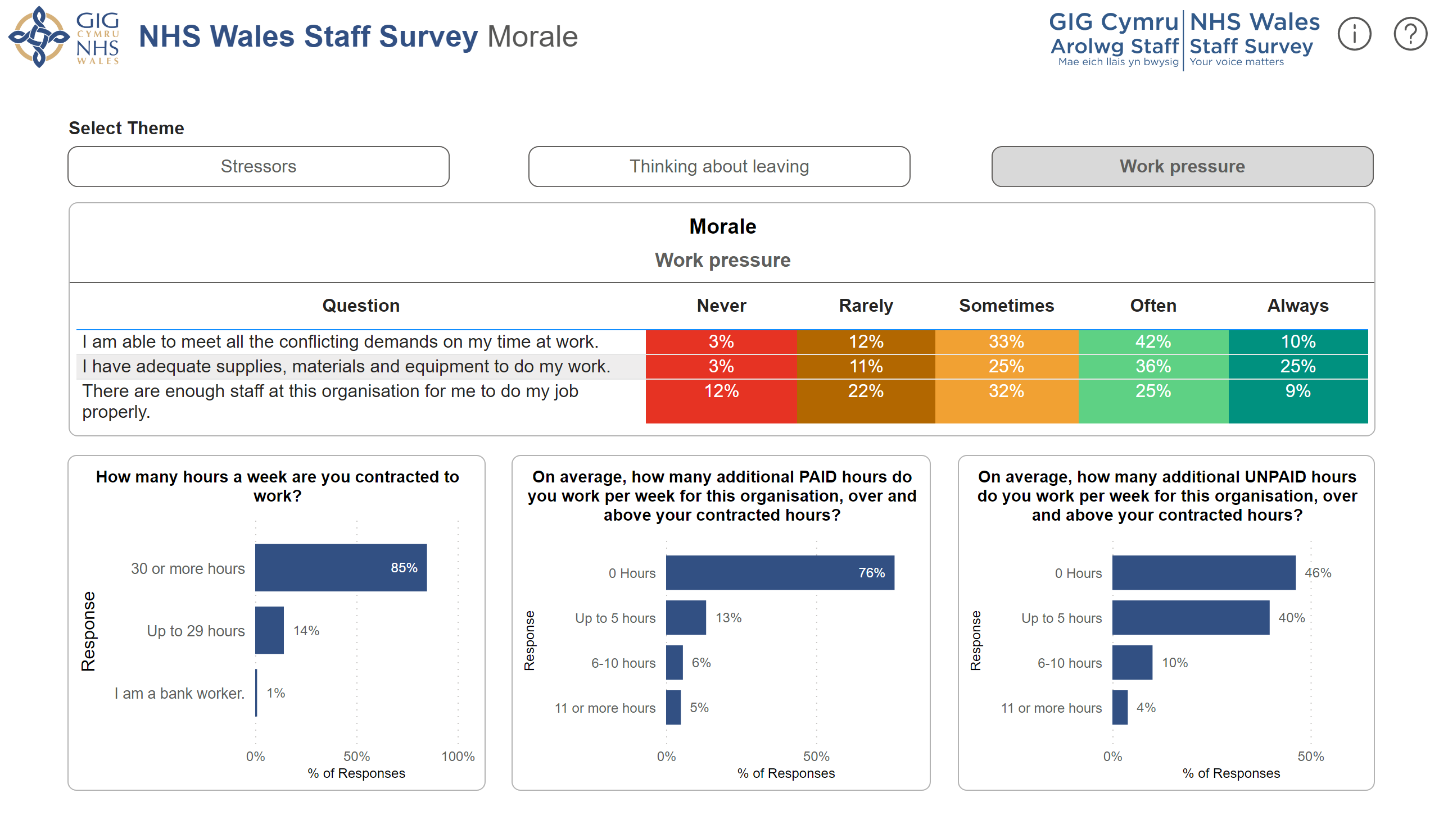
Morale (3)
Notes:
On average, how many additional UNPAID hours do you work per week for this organisation, over and above your contracted hours?
No alt text provided
On average, how many additional PAID hours do you work per week for this organisation, over and above your contracted hours?
No alt text provided
How many hours a week are you contracted to work?
No alt text provided
Morale
No alt text provided
NHS Wales Logo
No alt text provided
Strapline
No alt text provided
Staff Survey Logo
No alt text provided
Question Mark
No alt text provided
Exclamation Mark
No alt text provided
Theme Text Box
No alt text provided
actionButton
No alt text provided
actionButton
No alt text provided
actionButton
No alt text provided
actionButton
No alt text provided
textbox
No alt text provided
shape
No alt text provided
textbox
No alt text provided
shape
No alt text provided
shape
No alt text provided

Slide 7
Patient Safety
Notes:
Patient Safety
No alt text provided
Patient Safety
No alt text provided
actionButton
No alt text provided
textbox
No alt text provided
shape
No alt text provided
shape
No alt text provided
NHS Wales Logo
No alt text provided
Staff Survey Logo
No alt text provided
Strapline
No alt text provided
Question Mark
No alt text provided
Exclamation Mark
No alt text provided

Slide 8
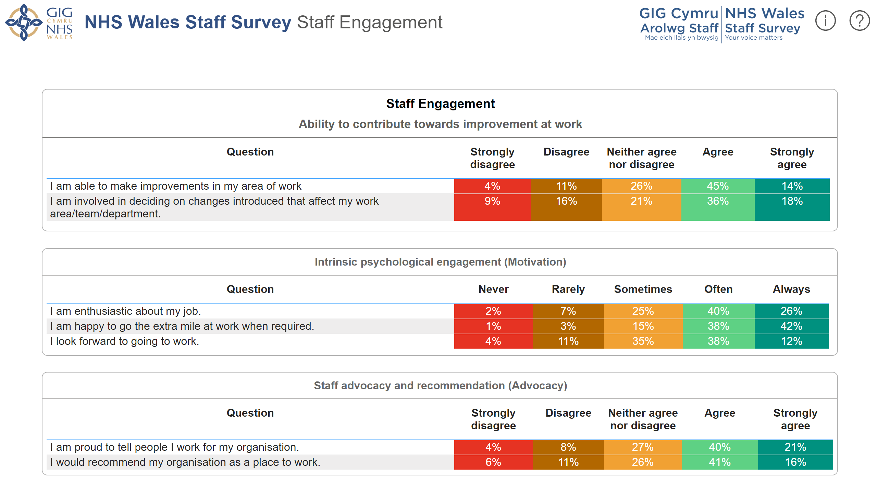
Staff Engagement
Notes:
NHS Wales Logo
No alt text provided
Staff Survey Logo
No alt text provided
Strapline
No alt text provided
Question Mark
No alt text provided
Exclamation Mark
No alt text provided
Intrinsic psychological engagement (Motivation)
No alt text provided
Staff advocacy and recommendation (Advocacy)
No alt text provided
Staff Engagement
No alt text provided
actionButton
No alt text provided
textbox
No alt text provided
shape
No alt text provided
shape
No alt text provided

Slide 9
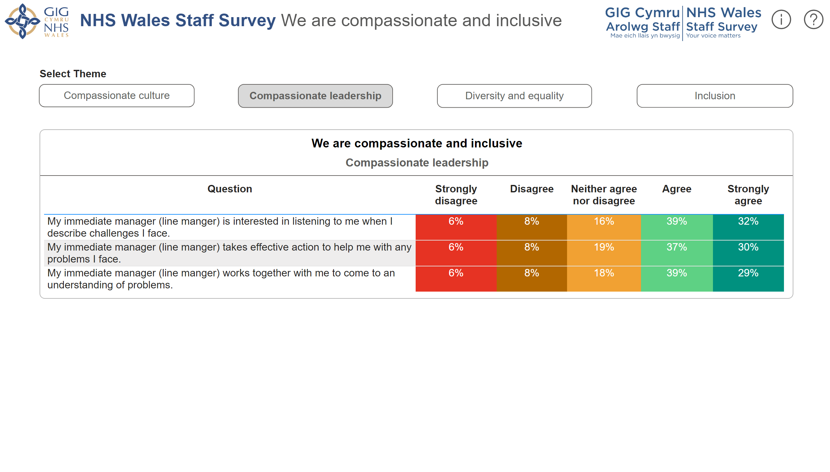
We are compassionate and inclusive (2)
Notes:
We are compassionate and inclusive
No alt text provided
NHS Wales Logo
No alt text provided
Staff Survey Logo
No alt text provided
Strapline
No alt text provided
Question Mark
No alt text provided
Exclamation Mark
No alt text provided
Theme Text Box
No alt text provided
actionButton
No alt text provided
actionButton
No alt text provided
actionButton
No alt text provided
actionButton
No alt text provided
actionButton
No alt text provided
textbox
No alt text provided
shape
No alt text provided
textbox
No alt text provided
shape
No alt text provided
shape
No alt text provided

Slide 10
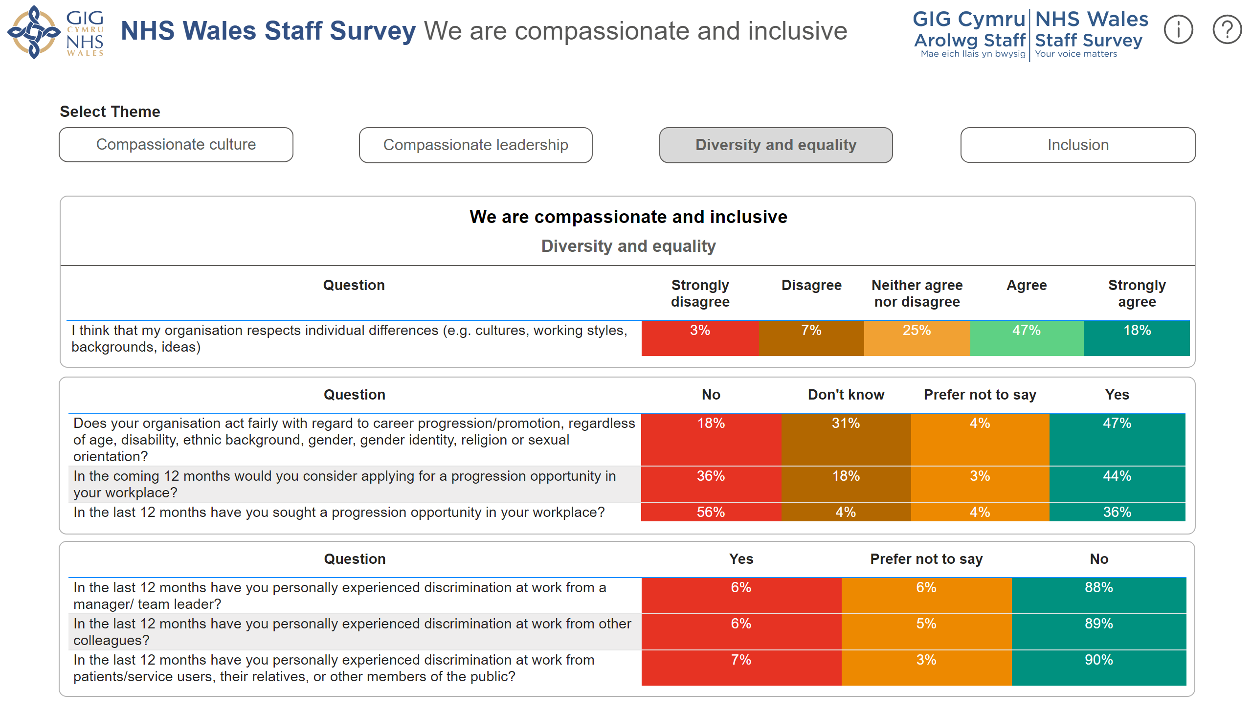
We are compassionate and inclusive (3)
Notes:
NHS Wales Logo
No alt text provided
Staff Survey Logo
No alt text provided
Strapline
No alt text provided
Question Mark
No alt text provided
Exclamation Mark
No alt text provided
We are compassionate and inclusive
No alt text provided
tableEx
No alt text provided
tableEx
No alt text provided
Theme Text Box
No alt text provided
actionButton
No alt text provided
actionButton
No alt text provided
actionButton
No alt text provided
actionButton
No alt text provided
actionButton
No alt text provided
textbox
No alt text provided
shape
No alt text provided
textbox
No alt text provided
shape
No alt text provided
shape
No alt text provided

Slide 11
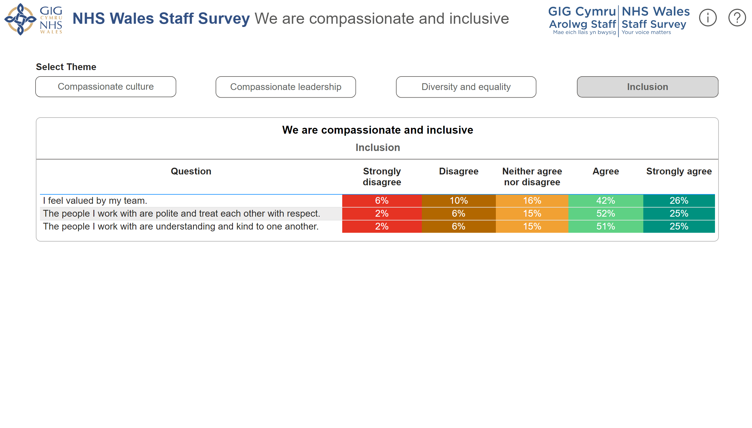
We are compassionate and inclusive (4)
Notes:
We are compassionate and inclusive
No alt text provided
NHS Wales Logo
No alt text provided
Staff Survey Logo
No alt text provided
Strapline
No alt text provided
Question Mark
No alt text provided
Exclamation Mark
No alt text provided
Theme Text Box
No alt text provided
actionButton
No alt text provided
actionButton
No alt text provided
actionButton
No alt text provided
actionButton
No alt text provided
actionButton
No alt text provided
textbox
No alt text provided
shape
No alt text provided
textbox
No alt text provided
shape
No alt text provided
shape
No alt text provided

Slide 12
We recognise everyone's contribution
Notes:
We recognise everyone's contribution
No alt text provided
NHS Wales Logo
No alt text provided
Staff Survey Logo
No alt text provided
Strapline
No alt text provided
Question Mark
No alt text provided
Exclamation Mark
No alt text provided
actionButton
No alt text provided
textbox
No alt text provided
shape
No alt text provided
shape
No alt text provided

Slide 13
We are all able to speak up
Notes:
We are all able to speak up
No alt text provided
Theme Text Box
No alt text provided
actionButton
No alt text provided
actionButton
No alt text provided
NHS Wales Logo
No alt text provided
Staff Survey Logo
No alt text provided
Strapline
No alt text provided
Question Mark
No alt text provided
Exclamation Mark
No alt text provided
actionButton
No alt text provided
textbox
No alt text provided
shape
No alt text provided
textbox
No alt text provided
shape
No alt text provided
shape
No alt text provided

Slide 14
We are all able to speak up (2)
Notes:
We are all able to speak up
No alt text provided
Theme Text Box
No alt text provided
actionButton
No alt text provided
actionButton
No alt text provided
NHS Wales Logo
No alt text provided
Staff Survey Logo
No alt text provided
Strapline
No alt text provided
Question Mark
No alt text provided
Exclamation Mark
No alt text provided
actionButton
No alt text provided
textbox
No alt text provided
shape
No alt text provided
textbox
No alt text provided
shape
No alt text provided
shape
No alt text provided

Slide 15
We are stronger together
Notes:
We are stronger together
No alt text provided
Theme Text Box
No alt text provided
actionButton
No alt text provided
actionButton
No alt text provided
NHS Wales Logo
No alt text provided
Staff Survey Logo
No alt text provided
Strapline
No alt text provided
Question Mark
No alt text provided
Exclamation Mark
No alt text provided
actionButton
No alt text provided
textbox
No alt text provided
shape
No alt text provided
textbox
No alt text provided
shape
No alt text provided
shape
No alt text provided

Slide 16
We are stronger together (2)
Notes:
We are stronger together
No alt text provided
Theme Text Box
No alt text provided
actionButton
No alt text provided
actionButton
No alt text provided
NHS Wales Logo
No alt text provided
Staff Survey Logo
No alt text provided
Strapline
No alt text provided
Question Mark
No alt text provided
Exclamation Mark
No alt text provided
actionButton
No alt text provided
textbox
No alt text provided
shape
No alt text provided
textbox
No alt text provided
shape
No alt text provided
shape
No alt text provided

Slide 17
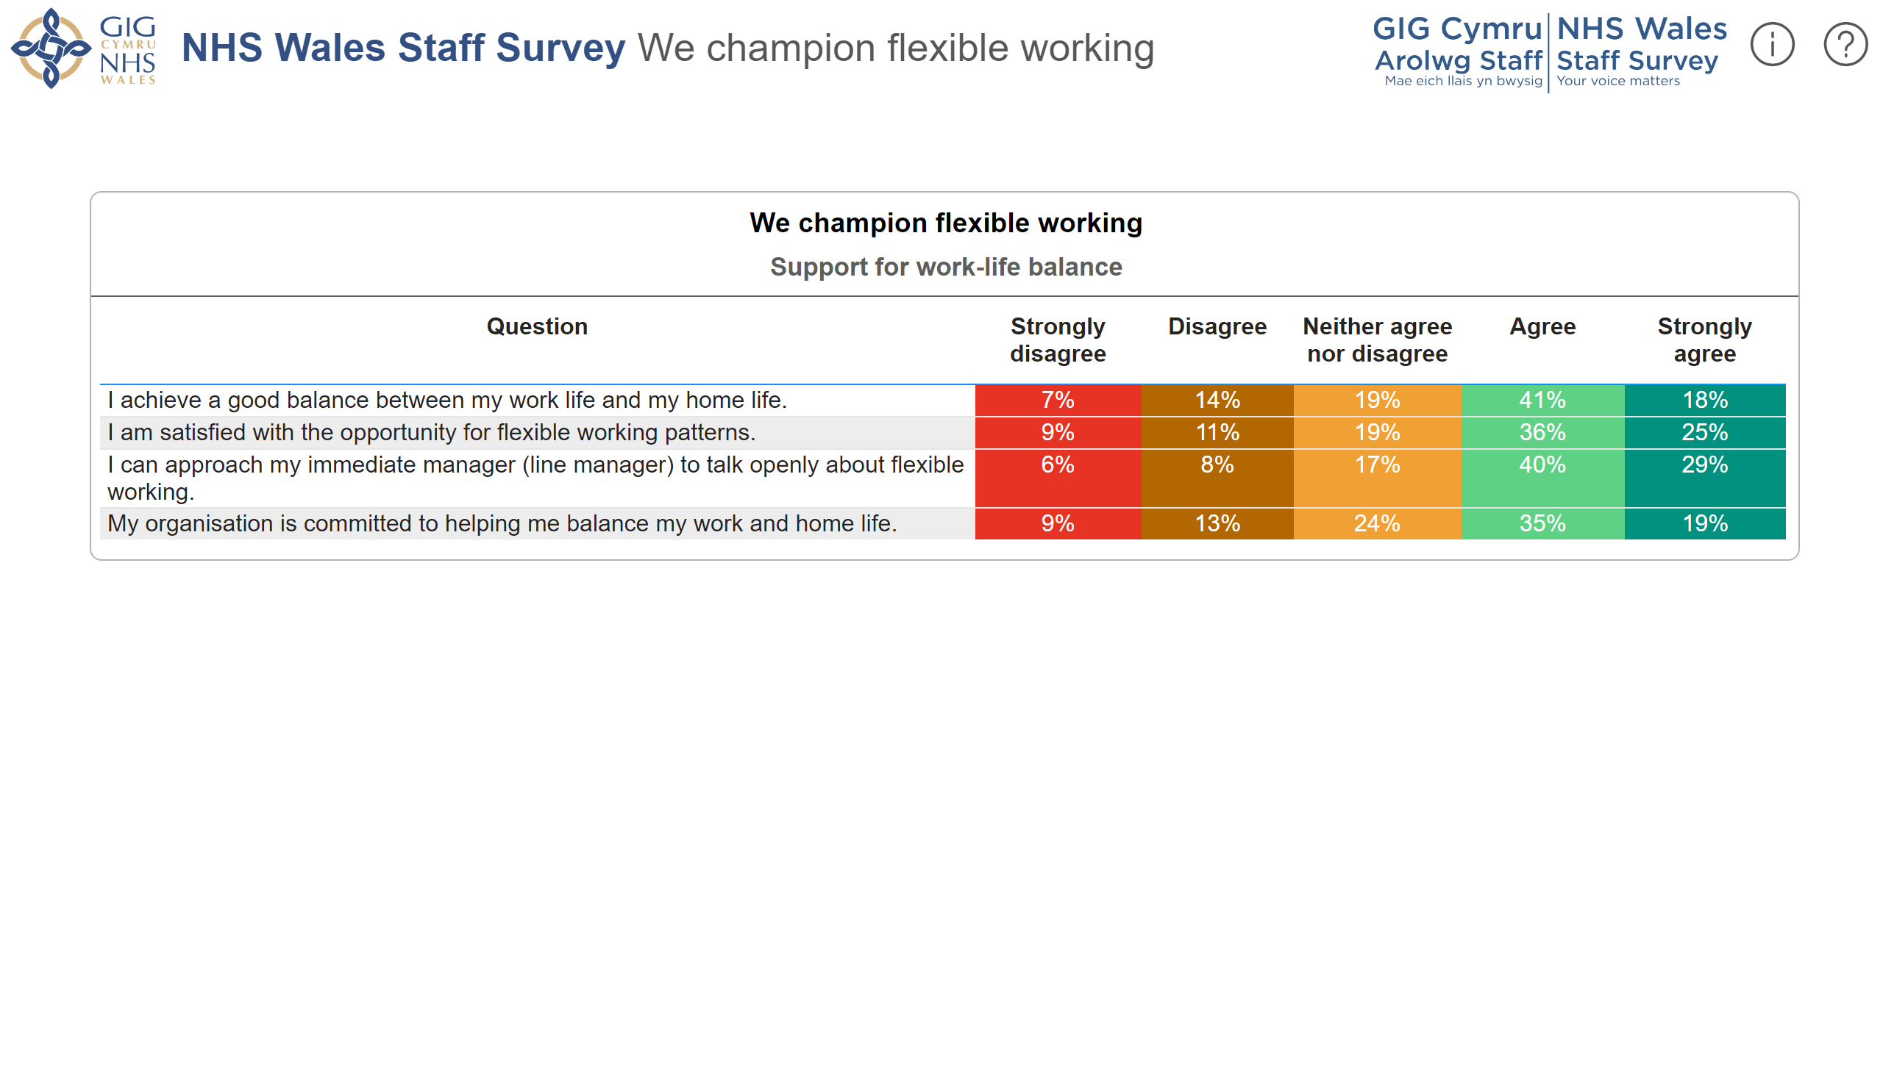
We champion flexible working
Notes:
We champion flexible working
No alt text provided
NHS Wales Logo
No alt text provided
Staff Survey Logo
No alt text provided
Strapline
No alt text provided
Question Mark
No alt text provided
Exclamation Mark
No alt text provided
shape
No alt text provided
textbox
No alt text provided
actionButton
No alt text provided
shape
No alt text provided

Slide 18
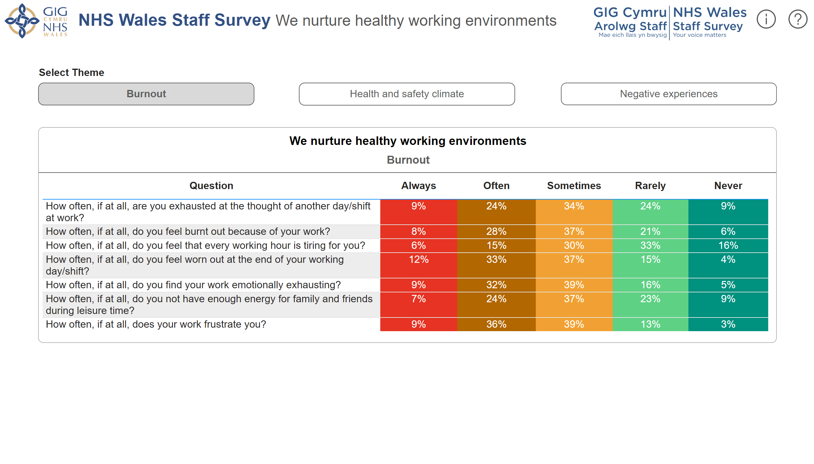
We nurture healthy working environments
Notes:
We nurture healthy working environments
No alt text provided
Theme Text Box
No alt text provided
actionButton
No alt text provided
actionButton
No alt text provided
actionButton
No alt text provided
NHS Wales Logo
No alt text provided
Staff Survey Logo
No alt text provided
Strapline
No alt text provided
Question Mark
No alt text provided
Exclamation Mark
No alt text provided
actionButton
No alt text provided
textbox
No alt text provided
shape
No alt text provided
textbox
No alt text provided
shape
No alt text provided
shape
No alt text provided

Slide 19
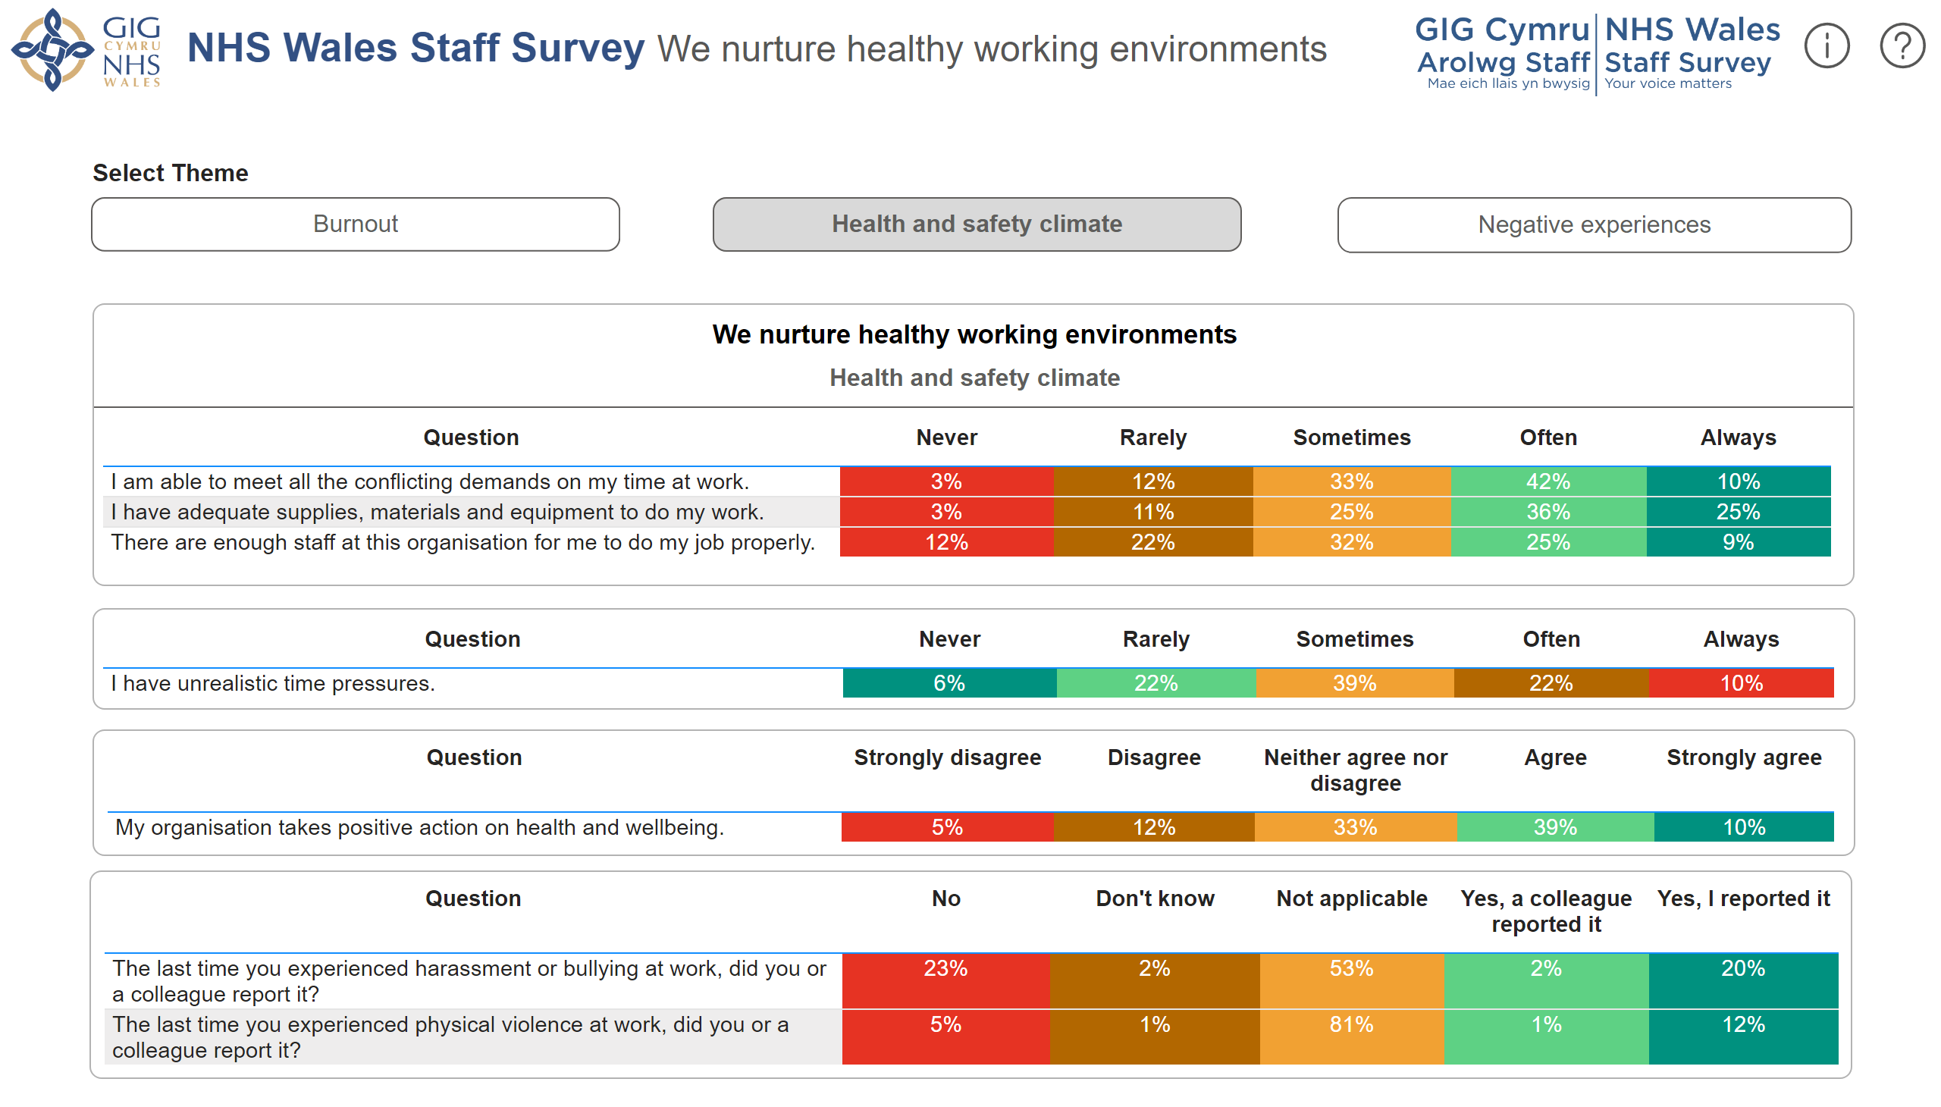
We nurture healthy working environments (2)
Notes:
NHS Wales Logo
No alt text provided
Staff Survey Logo
No alt text provided
Strapline
No alt text provided
Question Mark
No alt text provided
Exclamation Mark
No alt text provided
Theme Text Box
No alt text provided
actionButton
No alt text provided
actionButton
No alt text provided
actionButton
No alt text provided
We nurture healthy working environments
No alt text provided
We nurture healthy working environments
No alt text provided
tableEx
No alt text provided
Table 1
No alt text provided
actionButton
No alt text provided
textbox
No alt text provided
shape
No alt text provided
textbox
No alt text provided
shape
No alt text provided
shape
No alt text provided

Slide 20
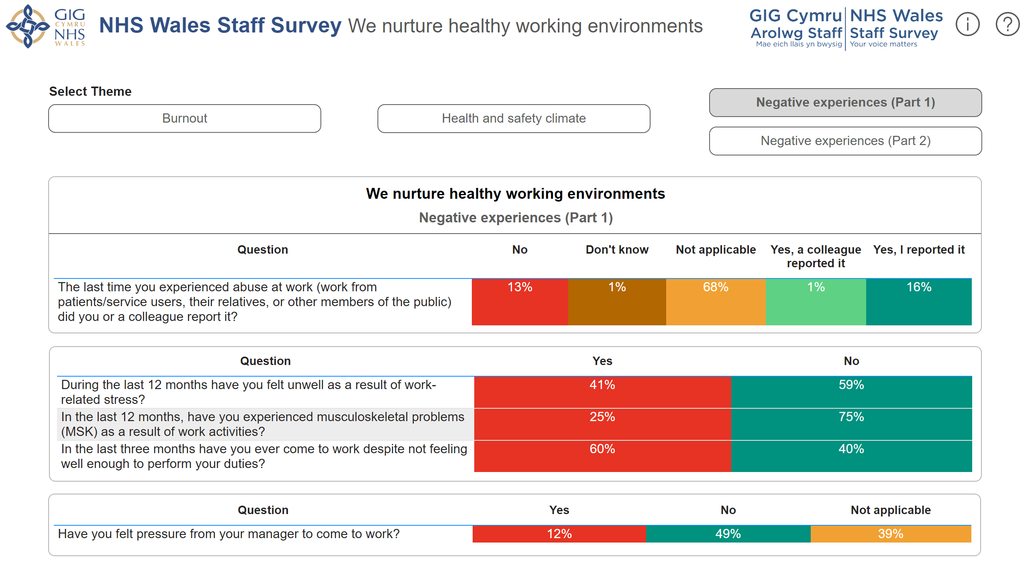
We nurture healthy working environments (3)
Notes:
We nurture healthy working environments
No alt text provided
tableEx
No alt text provided
We nurture healthy working environments
No alt text provided
NHS Wales Logo
No alt text provided
Staff Survey Logo
No alt text provided
Strapline
No alt text provided
Question Mark
No alt text provided
Exclamation Mark
No alt text provided
Theme Text Box
No alt text provided
actionButton
No alt text provided
actionButton
No alt text provided
actionButton
No alt text provided
actionButton
No alt text provided
actionButton
No alt text provided
textbox
No alt text provided
shape
No alt text provided
textbox
No alt text provided
shape
No alt text provided
shape
No alt text provided

Slide 21
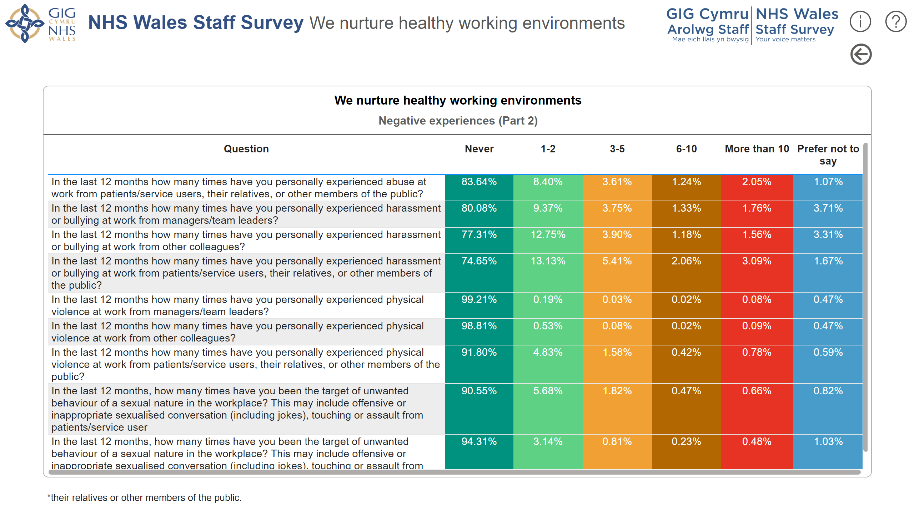
We nurture healthy working environments (4)
Notes:
Back Button
No alt text provided
NHS Wales Logo
No alt text provided
Staff Survey Logo
No alt text provided
Strapline
No alt text provided
Question Mark
No alt text provided
Exclamation Mark
No alt text provided
We nurture healthy working environments
No alt text provided
actionButton
No alt text provided
textbox
No alt text provided
shape
No alt text provided
shape
No alt text provided
We nurture healthy working environments
No alt text provided
We nurture healthy working environments
No alt text provided

Slide 22
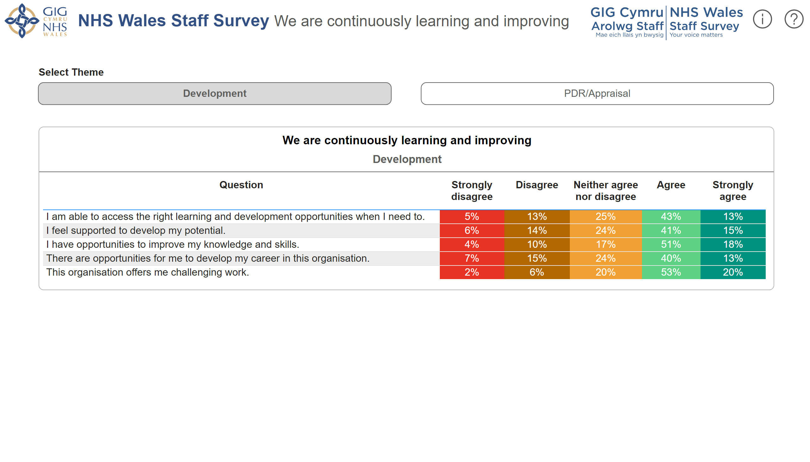
We are continuously learning and improving
Notes:
We are continuously learning and improving
No alt text provided
NHS Wales Logo
No alt text provided
Staff Survey Logo
No alt text provided
Strapline
No alt text provided
Question Mark
No alt text provided
Exclamation Mark
No alt text provided
Theme Text Box
No alt text provided
actionButton
No alt text provided
actionButton
No alt text provided
actionButton
No alt text provided
textbox
No alt text provided
shape
No alt text provided
textbox
No alt text provided
shape
No alt text provided
shape
No alt text provided

Slide 23
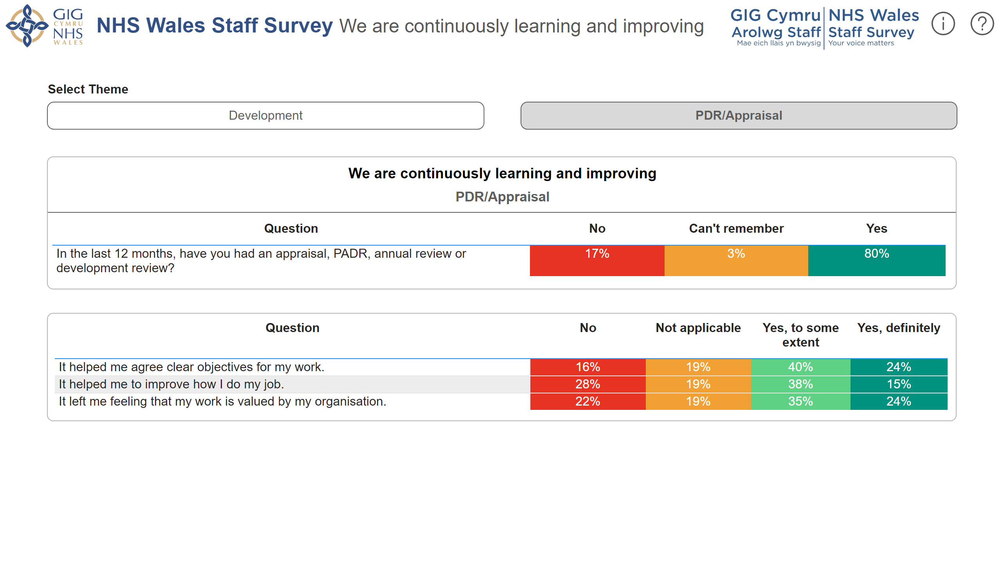
We are continuously learning and improving (2)
Notes:
We are continuously learning and improving
No alt text provided
tableEx
No alt text provided
Theme Text Box
No alt text provided
actionButton
No alt text provided
actionButton
No alt text provided
NHS Wales Logo
No alt text provided
Staff Survey Logo
No alt text provided
Strapline
No alt text provided
Question Mark
No alt text provided
Exclamation Mark
No alt text provided
actionButton
No alt text provided
textbox
No alt text provided
shape
No alt text provided
textbox
No alt text provided
shape
No alt text provided
shape
No alt text provided

Slide 24
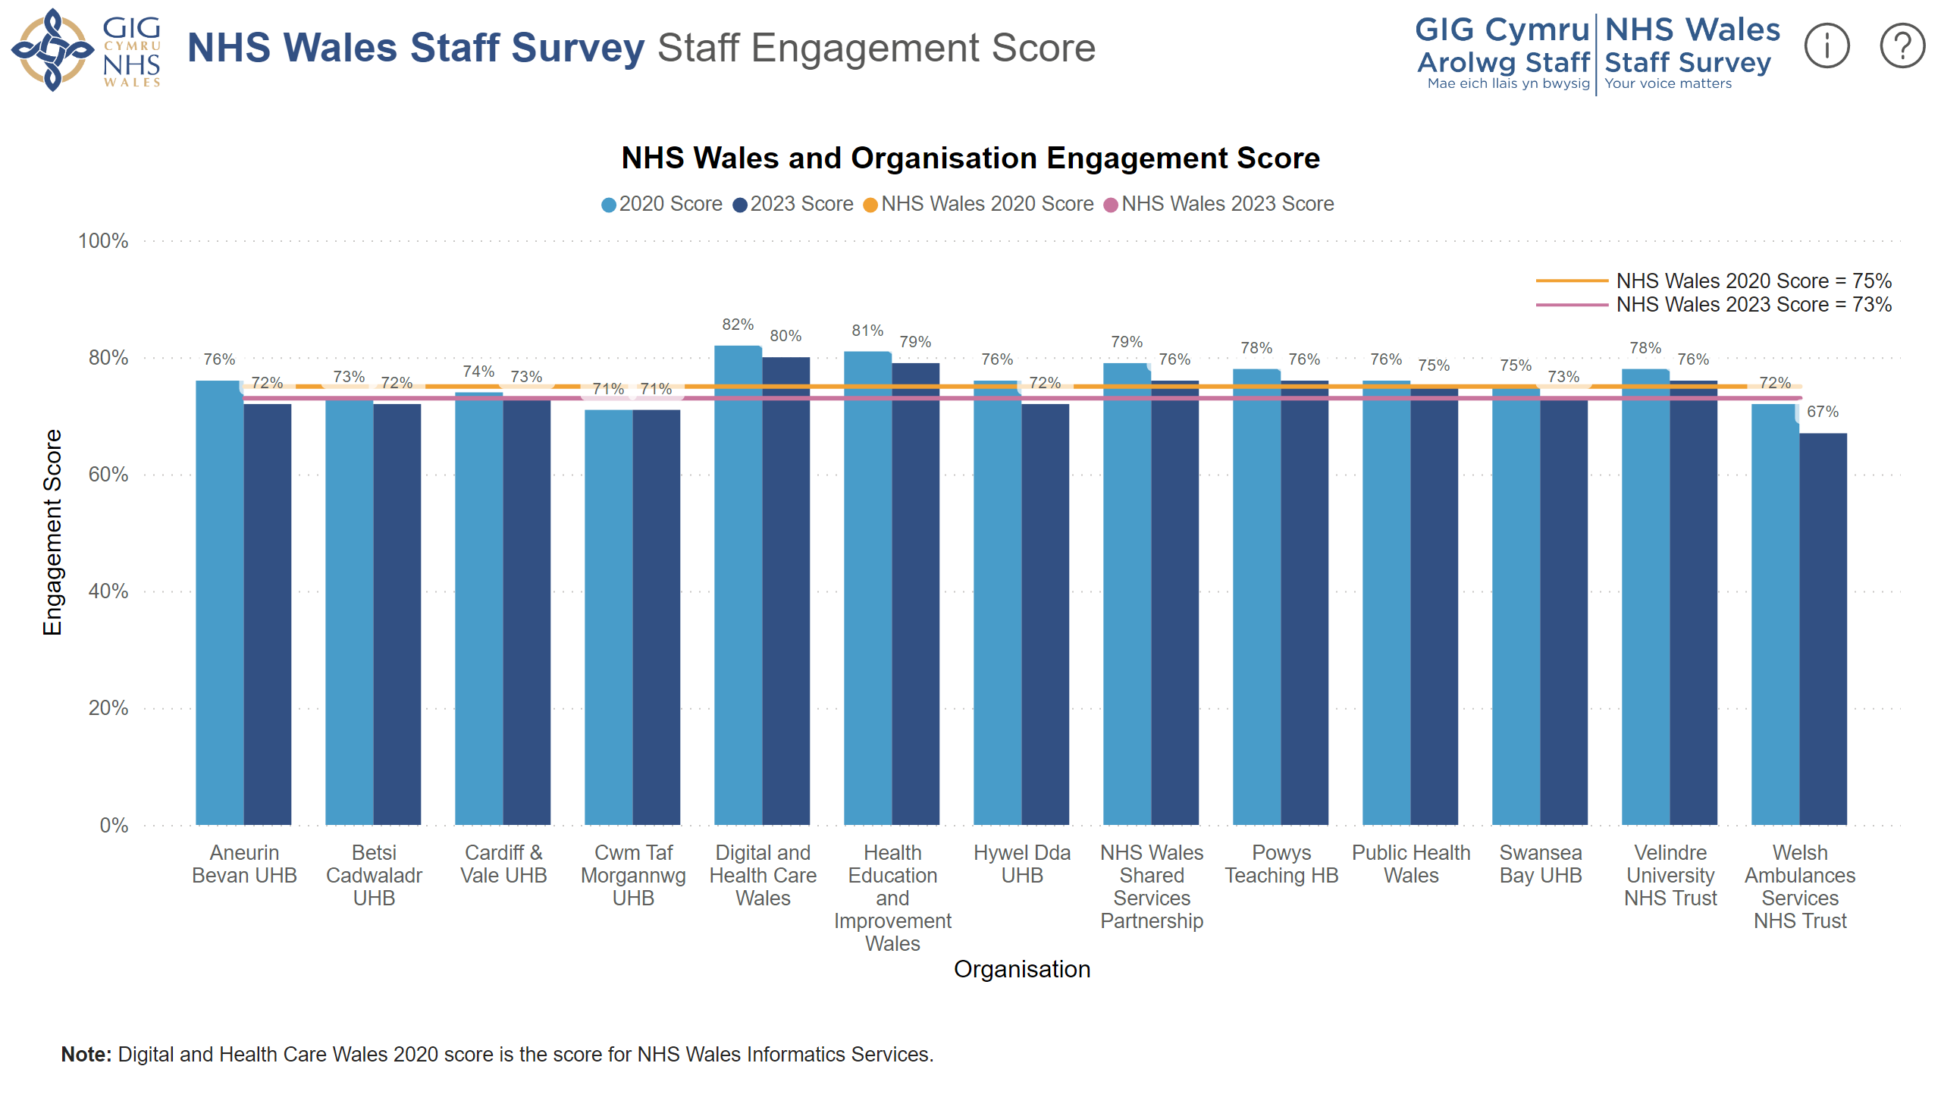
Staff Engagement Score
Notes:
Question Mark
No alt text provided
Exclamation Mark
No alt text provided
NHS Wales and Organisation Engagement Score
No alt text provided
Staff Survey Logo
No alt text provided
NHS Wales Logo
No alt text provided
Strapline
No alt text provided
Note
No alt text provided
textbox
No alt text provided
actionButton
No alt text provided
shape
No alt text provided
shape
No alt text provided
textbox
No alt text provided
shape
No alt text provided
shape
No alt text provided

